Slide 1
CSE 107: Object Oriented Programming Language
Dr. Tanzima Hashem
Professor
CSE, BUET

Slide 2
Dynamic Cast
A runtime cast that verifies the validity of the cast
General form
dynamic_cast<target-type> (expr)
target-type: the target type of the cast
expr: the expression being cast into the new type
the target type must be a pointer or reference type
the expression being cast must evaluate to a pointer or reference
cast one type of pointer to another or one type of reference to another

Slide 3
Dynamic Cast
Cast on polymorphic types
It succeeds only when it is properly casted
If the cast cannot be made, the cast fails
the expression evaluates to null if the cast involves pointers
A bad_cast exception is thrown if the cast involves reference type

Slide 4
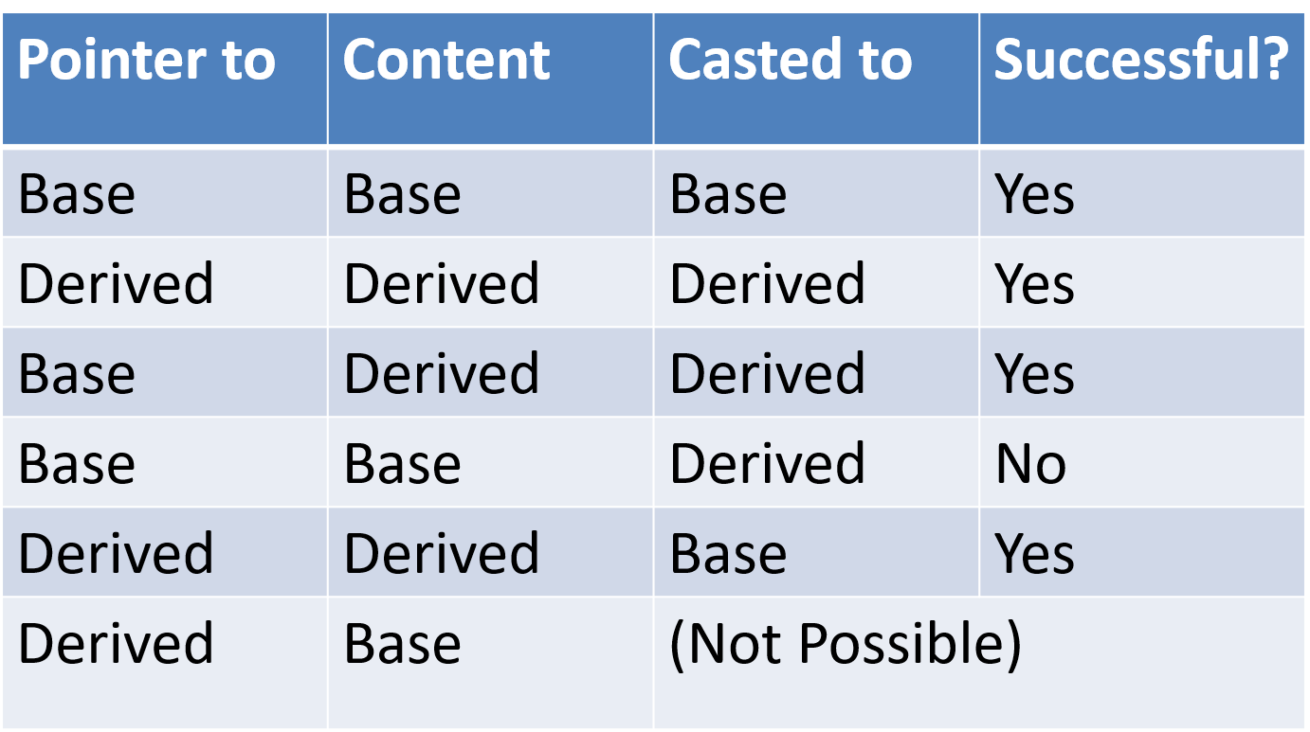
Dynamic Cast

Slide 5
Dynamic Cast
// Base is a polymorphic class and Derived is derived from Base
Base * bp, b_ob;
Derived *dp, d_ob;
bp = &d_ob;
dp = dynamic_cast<Derived *> (bp);
if (dp) cout << “Cast OK”;
else cout << “Cast Fails”;
Output: Cast OK

Slide 6
Dynamic Cast
// Base is a polymorphic class and Derived is derived from Base
Base * bp, b_ob;
Derived *dp, d_ob;
bp = &b_ob;
dp = dynamic_cast<Derived *> (bp);
if (dp) cout << “Cast OK”;
else cout << “Cast Fails”;
Output: Cast Fails

Slide 7
Dynamic Cast
#include<iostream>
#include<typeinfo>
using namespace std;
class Base{
public:
virtual void f() {}
};
class Derived: public Base{
public:
void derivedOnly(){
cout << "Is a Derived Object\n";
}
};
int main(){
Base *bp, b_ob;
Derived *dp, d_ob;
bp=&b_ob; if(typeid(*bp)==typeid(Derived)){ dp=(Derived *) bp;
dp-> derivedOnly();
}
else cout << "Failed\n";
bp=&d_ob; if(typeid(*bp)==typeid(Derived)){ dp=(Derived *) bp;
dp-> derivedOnly();
}
else cout << "Cast should work\n"; return 0;
}

Slide 8
Dynamic Cast
#include<iostream>
#include<typeinfo>
using namespace std;
class Base{
public:
virtual void f() {}
};
class Derived: public Base{
public:
void derivedOnly(){
cout << "Is a Derived Object\n";
}
};
int main(){
Base *bp, b_ob;
Derived *dp, d_ob;
bp=&b_ob;
dp= dynamic_cast<Derived *> (bp);
if(dp) dp-> derivedOnly();
else cout << "Failed\n";
bp=&d_ob;
dp= dynamic_cast<Derived *> (bp);
if(dp) dp-> derivedOnly();
else cout << " Cast should work\n ";
return 0;
}

Slide 9
Dynamic Cast
#include<iostream>
using namespace std;
class Base{
public:
virtual void f() {}
};
class Derived1: public Base{
public:
void derived1Only(){
cout << "Is a Derived1 Object\n";
}
};
class Derived2: public Base{
public:
void derived2Only(){
cout << "Is a Derived2 Object\n";
}
};

Slide 10
Dynamic Cast
Base * generator()
{
switch(rand()%2){
case 0: return new Derived1;
case 1: return new Derived2;
}
}
int main()
{
Base *p1;
Derived1 *p2;
Derived2 *p3;
for(int i=0; i<10; i++)
{
p1=generator();
p2 = dynamic_cast<Derived1*> (p1);
if(p2) cout << “Derived1 object\n”;
p3 = dynamic_cast<Derived2 *> (p1);
if(p3) cout << “Derived2 object\n”;
}
return 0;
}

Slide 11
The End
Acknowledgement
http://faizulbari.buet.ac.bd/Courses.html
http://mhkabir.buet.ac.bd/cse201/index.html
Topic Covered: Sections 12.2

